Slide 1
BUSINESS PROCESS REENGINEERING
(PHASES 3 & 4)
by
Mustafa Shiraz Ahmed
LECTURE 6

Slide 2
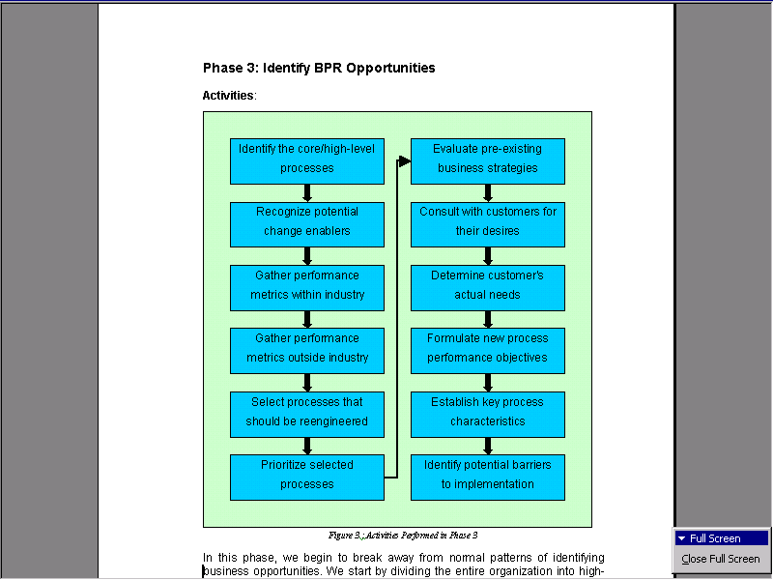
Phase 3 : Identify BPR Opportunities

Slide 3
Phase 3 : Identify BPR Opportunities
In this phase, we begin to break away from normal patterns of identifying business opportunities.
We start by dividing the entire organization into high-level processes rather than the usual vertical business areas such as marketing, production, finance, etc.

Slide 4
Phase 3 : Identify BPR Opportunities
These processes, usually less than a dozen, are the major or core processes of the organization.
This activity is not a time consuming task, but it is difficult because it requires a shift in how we think of ourselves.

Slide 5
Phase 3 : Identify BPR Opportunities
One goal here is to identify the process boundaries (where the process begins and where it ends), which will help set the project scope for those processes that are to be reengineered.

Slide 6
Phase 3 : Identify BPR Opportunities
In many cases, seeing the company from the customer’s point of view can help identify what these high-level processes might be.

Slide 7
Phase 3 : Identify BPR Opportunities
For example, when Texas Instruments outlined their major processes for their semiconductor business, they came up with only six processes as follows:
  Strategy Development
  Product Development
  Customer Design and Support
  Order Fulfillment
  Manufacturing Capability Development
  Customer Communications.

Slide 8
Phase 3 : Identify BPR Opportunities
At this point, it is helpful to begin thinking about potential change levers which may lead to dramatic changes in the organization’s processes.
Change levers usually will fall under one of three categories:
  the use of information,
  the use of information technology
  human factors.

Slide 9
Phase 3 : Identify BPR Opportunities
What new information is available and easily accessible to the organization?
What new technologies have recently been introduced, or are on the horizon, that can change how businesses and customers interact?
What new ways of structuring cross-functional work teams, compensation systems, and incentive methods have proven to be effective in improving operations within other organizations?

Slide 10
Phase 3 : Identify BPR Opportunities
Once the major processes have been defined, we need to decide which of our high-level processes needs to be reengineered.
The most objective and accurate way is to compare the performance of our high-level processes, identified earlier, with the performance of our competitors as well as organizations outside of our industry.

Slide 11
Phase 3 : Identify BPR Opportunities
Even if we outperform our direct competition, there may be companies in other industries which may be much more effective in performing a similar task -- such as order fulfillment or product development.
If we fulfill orders in six months, while a competitor fulfills orders in two weeks, we may consider this a process that needs to be reengineered.

Slide 12
Phase 3 : Identify BPR Opportunities
What we are looking for here are overall, bottom-line performance metrics for the high-level processes that will help us select which of these processes to reengineer.

Slide 13
Phase 3 : Identify BPR Opportunities
Typically, organizations use the following three criteria:
• Dysfunction (which processes are the most ineffective)
• Importance (which processes have the greatest impact on our customers)
• Feasibility (which processes are at the moment most susceptible to accomplish a successful redesign, or which ones are the "low hanging fruit" as many experts call them).

Slide 14
Phase 3 : Identify BPR Opportunities
Picking the "low hanging fruit" can show quick success and help build the much needed momentum and enthusiasm at all levels of the organization.
Prioritizing the processes we have chosen to reengineer guides us in scheduling the order we will reengineer these processes.

Slide 15
Phase 3 : Identify BPR Opportunities
Going after the highest priority process first, we assess the preexisting business strategy which governed its component tasks.
Most likely, this existing business strategy is not focused on driving a process; therefore, we will have to define a new process strategy to reflect our new strategic goals for the process

Slide 16
Phase 3 : Identify BPR Opportunities
Process customers are an important source of information to help set the new direction.
We must consult with them to not only discover their desires, but also to find out what they actually need by watching what they do with our output.

Slide 17
Phase 3 : Identify BPR Opportunities
Process goals and objectives can be determined by combining customer needs with competitor benchmarks and "best of industry" practices (metrics on the best performers of a similar process in other industries).
In addition to goals and objectives, we need to complete the conception of the new process by identifying key performance measures, key process characteristics, critical success factors, and potential barriers to implementation.

Slide 18
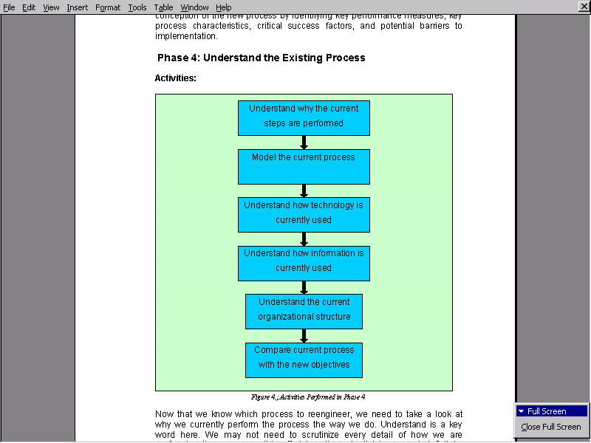
Phase 4 : Understand the Existing Process

Slide 19
Phase 4 : Understand the Existing Process
Now that we know which process to reengineer, we need to take a look at why we currently perform the process the way we do.
Understand is a key word here.
We may not need to scrutinize every detail of how we are performing the process -- this effort has the potential to go on indefinitely, sometimes referred to as analysis paralysis, which can weaken the momentum needed to carry the project all the way to implementation.

Slide 20
Phase 4 : Understand the Existing Process
What we need to do is understand the underlying reasons why the existing process is carried out the way it is, so that we can question those assumptions during our reengineering sessions later on.
When we have the new process objectives clearly defined (in Phase 3), we can measure our existing process in terms of the new objectives to see where we are and how far we have to go.

Slide 21
Phase 4 : Understand the Existing Process
Modeling the current process is an important part of this phase.
It not only helps us to better understand the existing process, but also helps with planning the migration from the old to the new process and executing the physical transformation of personnel, organizational structures, information requirements, and how technology is used.

Slide 22
Phase 4 : Understand the Existing Process
Information that should be included in the models are process inputs (such as task, times, data requirements, resources, demand, etc.) and process outputs (such as data outputs, cost, throughput, cycle time, bottlenecks, etc.).

Slide 23
Phase 4 : Understand the Existing Process
Understanding how and why the current processes use information is also important.
Do staff members have access to essential information?
Are some business areas wasting time and effort by creating duplicate information when it can be shared across organizational boundaries?
Why is technology used to support some tasks and not others?

Slide 24
Phase 4 : Understand the Existing Process
How effective are the current interfaces?
Are they easy to use, or are they counter-intuitive and thus inhibit the effectiveness of current tasks?
In what way does the existing process take advantage of technology, and in what way has technology imposed artificial restrictions?
We need to end up with an estimate of the current cost, robustness, and functional value of each technology and information systems currently being used.

